Slide 1


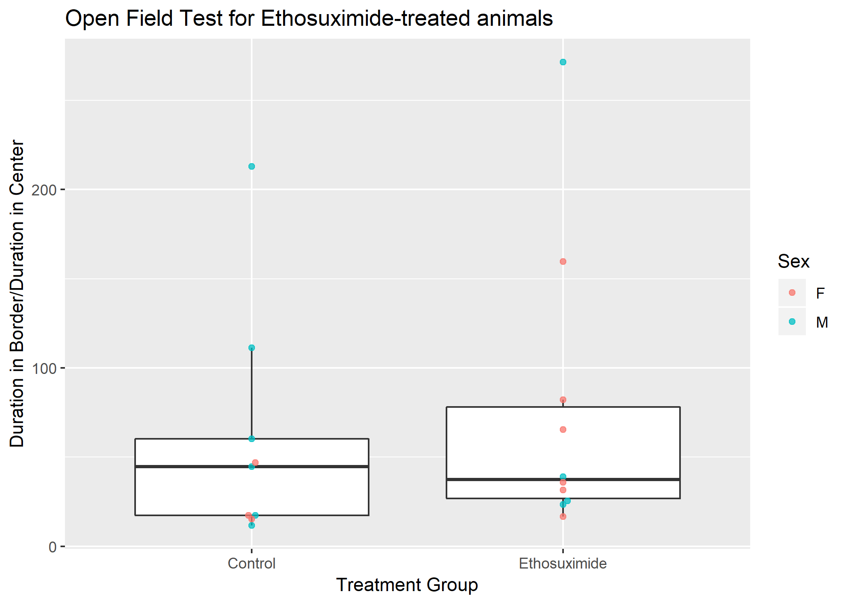
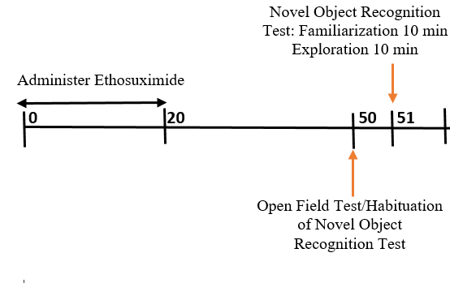
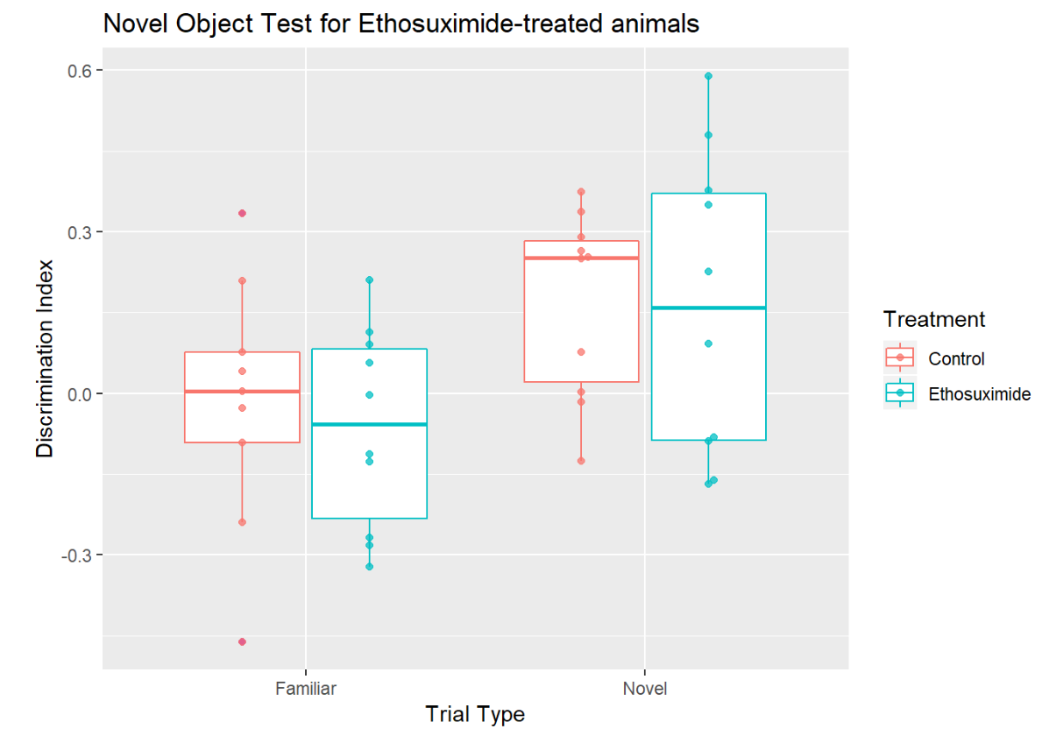
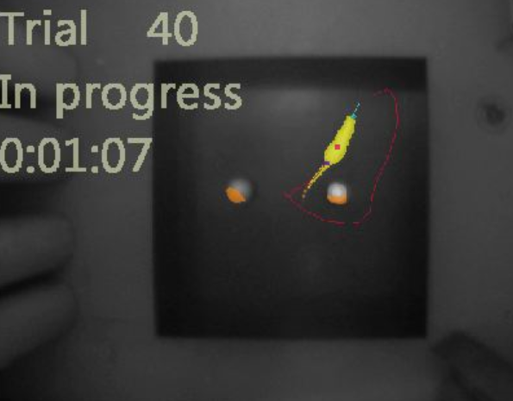
Effect of Ethosuximide Treatment During Neural Development on Adult Behavior
Alexa Gracias^{1,2}, Viktoria Usova^{1,2}, Mark Beenhakker¹
Pharmacology Department¹ and Neuroscience Undergraduate Program², University of Virginia, Charlottesville, VA
Introduction
Childhood Absence Epilepsy is the most common pediatric epilepsy
Current treatment is administered during a crucial period for neural development
Effect of treatment on normal neural development is unknown
Among common treatments, ethosuximide is most effective with reduced side effects
Aim: Determine whether chronic ethosuximide treatment during neural development influences adult behavior.
Results
Conclusions
Open Field
No significant difference between exploration for in border and in center between treatment groups
Novel Object Recognition
Significant difference between the familiar and novel object trials within each treatment group
No significant difference in discrimination index between control and ethosuximide treatment.
Limitations
Small sample size
Tracking software difficult to work with
Methods
Intraperitoneal Injections
p10-p30, Sprague Dawley rats
200mg/kg Ethosuximide or Saline (control)
n=10 per treatment group
Open Field
10 min habituation
Novel Object Recognition
10 min familiarization
10 min exploration
Arena: 91cmX91cmX35cm
Ethovision tracking software
Figure 1: Ratio of duration in border and duration in center between treatment groups. Mean duration in center: control= 21.5 s, ethosuximide = 15.3s. Welch two sample t-test: p=0.549.
Future Research
Effect of ethosuximide treatment on social interaction behavior
Effect of ethosuximide treatment on EEG sleep analysis
Acknowledgements
Thank you to Michael Scott and Brandon Newmyer for assistance with behavior equipment and protocol. Thank you to Adam Lu for assistance with data analysis. Thank you to Finnegan O’Dell for help during the injection phase. Thank you to members of Beenhakker lab for support.
References
Antunes, M., and G. Biala. “The Novel Object Recognition Memory: Neurobiology, Test Procedure, and Its Modifications.” Cognitive Processing13.2 (2012): 93–110. PMC. Web. 7 Nov. 2017.
Glauser, Tracy A. et al. Ethosuximide, Valproic Acid, and Lamotrigine in Childhood Absence Epilepsy. The New England journal of medicine 362.9 (2010): 790–799. PMC. Web. https://www.ncbi.nlm.nih.gov/pmc/articles/PMC2924476/#R2
Glauser, T. A., Cnaan, A., Shinnar, S., Hirtz, D. G., Dlugos, D., Masur, D., Clark, P. O., Adamson, P. C. and for the Childhood Absence Epilepsy Study Team (2013), Ethosuximide, valproic acid, and lamotrigine in childhood absence epilepsy: Initial monotherapy outcomes at 12 months. Epilepsia, 54: 141–155. doi:10.1111/epi.12028 http://onlinelibrary.wiley.com/doi/10.1111/epi.12028/full
Ponnusamy, R., & Pradhan, N. (2006). The effects of chronic administration of ethosuximide on learning and memory: a behavioral and biochemical study on nonepileptic rats. Behavioural Pharmacology, 17(7). Retrieved from https://journals.lww.com/behaviouralpharm/Fulltext/2006/11000/The_effects_of_chronic_administration_of.2.aspx
Seibenhener, Michael L., and Michael C. Wooten. “Use of the Open Field Maze to Measure Locomotor and Anxiety-like Behavior in Mice.” Journal of Visualized Experiments : JoVE 96 (2015): 52434. PMC. Web. 7 Nov. 2017.
Sengupta, Pallav. “The Laboratory Rat: Relating Its Age With Human’s.” International Journal of Preventive Medicine 4.6 (2013): 624–630. Print.
Vogel-Ciernia A, Wood MA. Examining object location and object recognition memory in mice. Curr Protoc Neurosci. 2014;69:8.31.1-17. Published 2014 Oct 8. doi:10.1002/0471142301.ns0831s69
Figure 2: Discrimination Index between treatment groups and trial type. Two way Anova: Trial Type= 0.00529 , Treatment=0.69606

